Slide 1
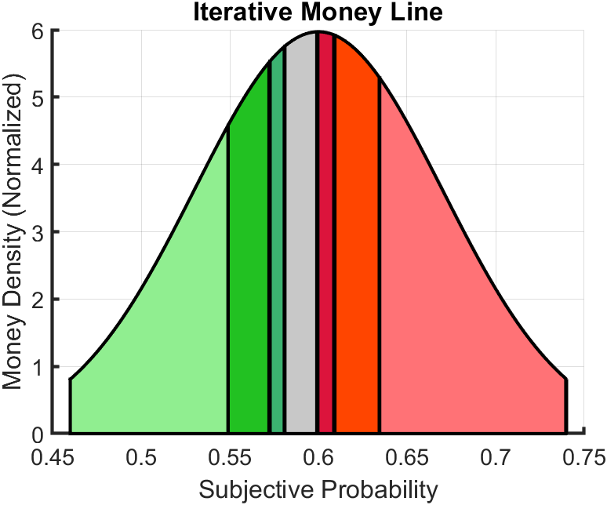






Money Line Iteration
Bet On Compliment
Bet On Focal
1
$β$ = 121.8
$α$ = 173.7
2
$β$ = 134
$α$ = 156
3
$β$ = 138.7
$α$ = 149.8
No Bet

